Slide 1

Activity 3
Crusher

Slide 2
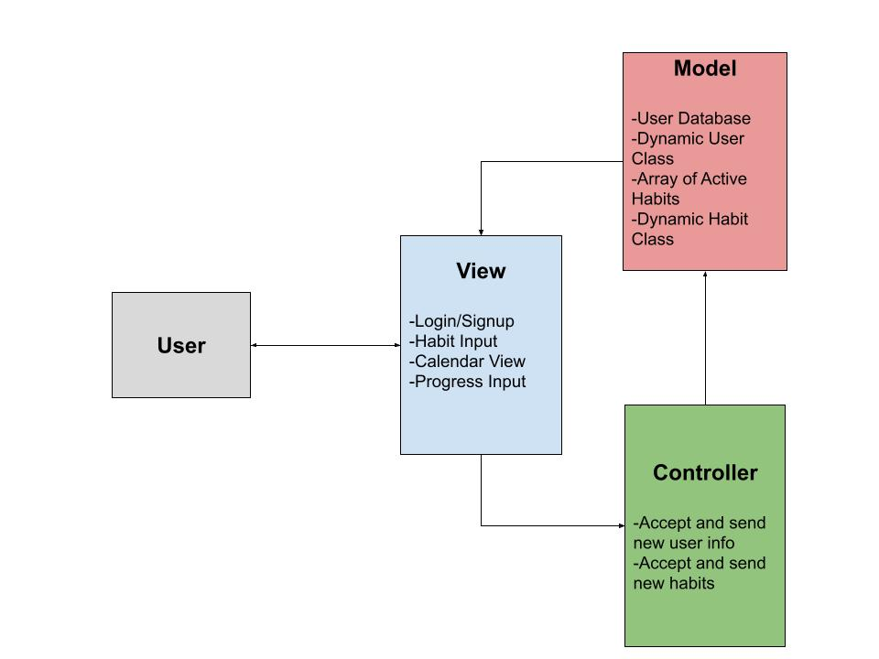
MVC Architecture Diagram

Slide 3
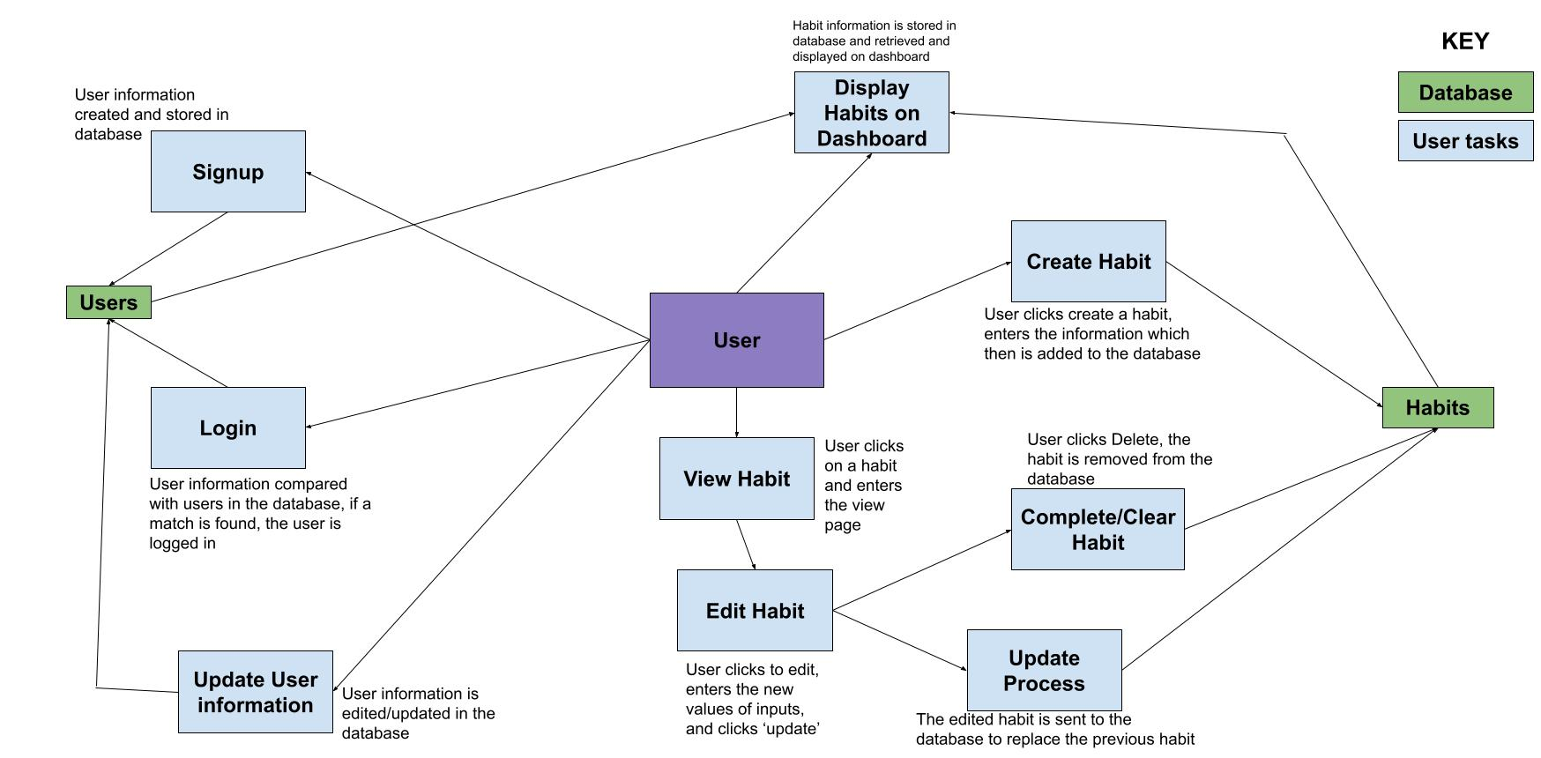
UML Data Flow Diagram

Slide 4
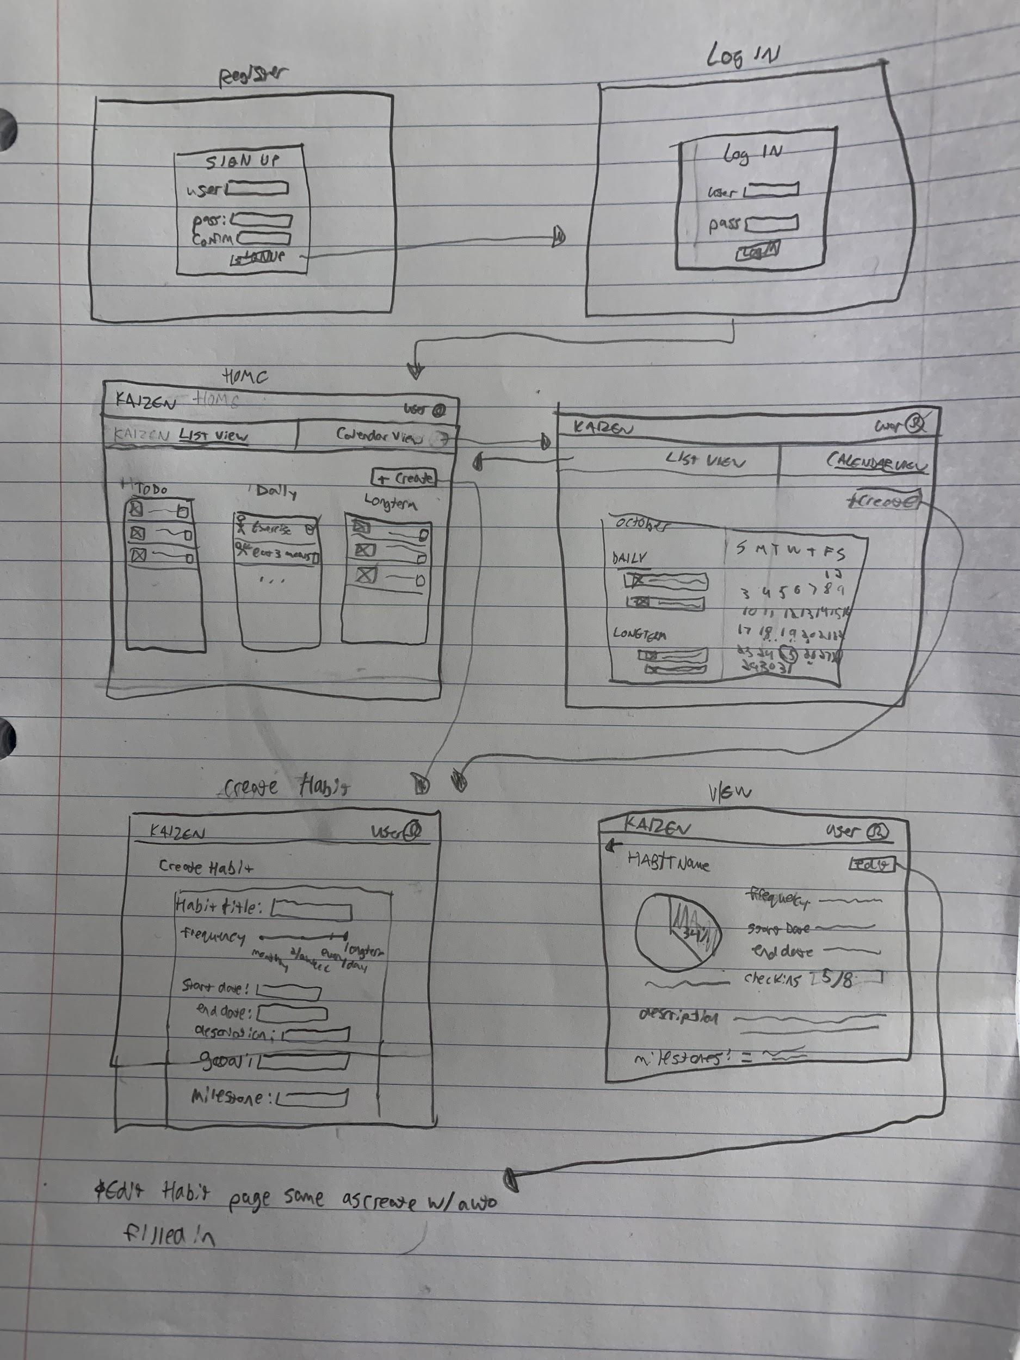
Lofi #1

Slide 5
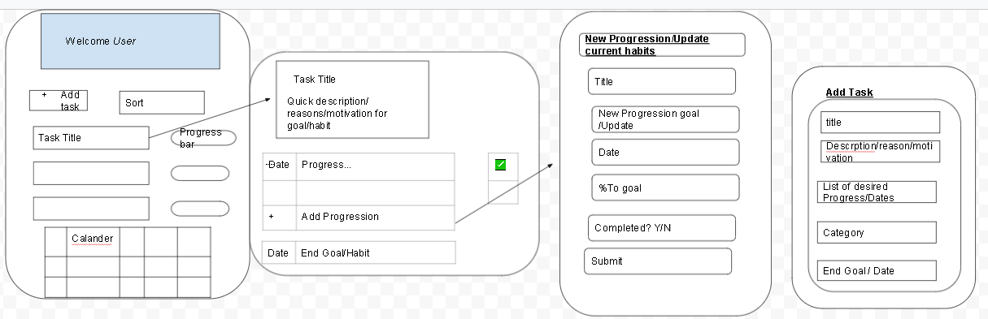
Lofi #2

Slide 6
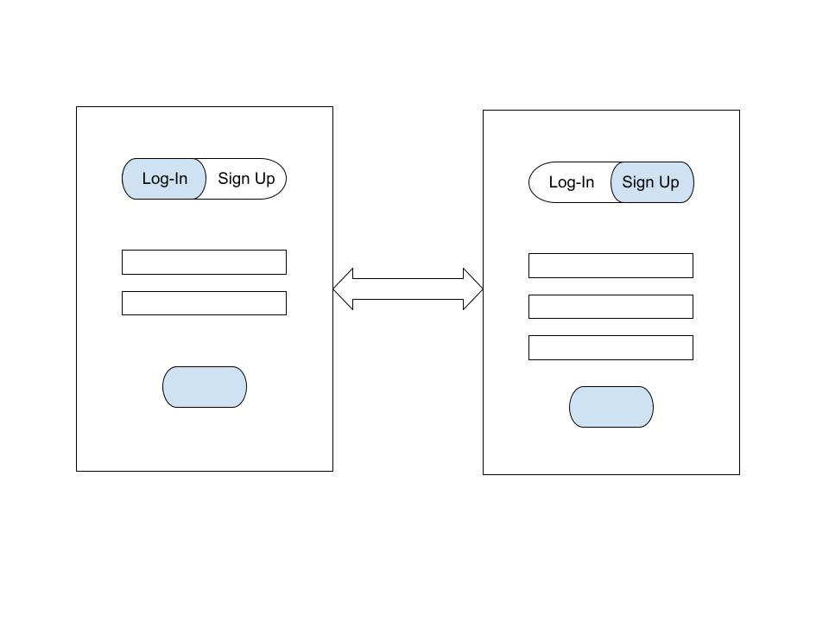
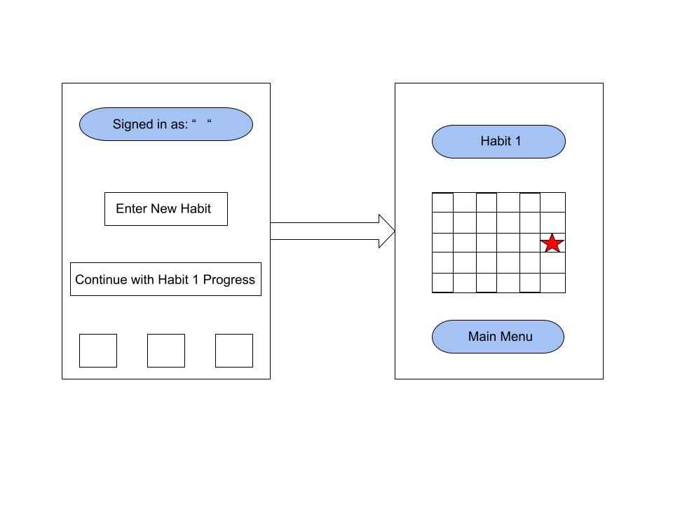
Lofi #3

Slide 7
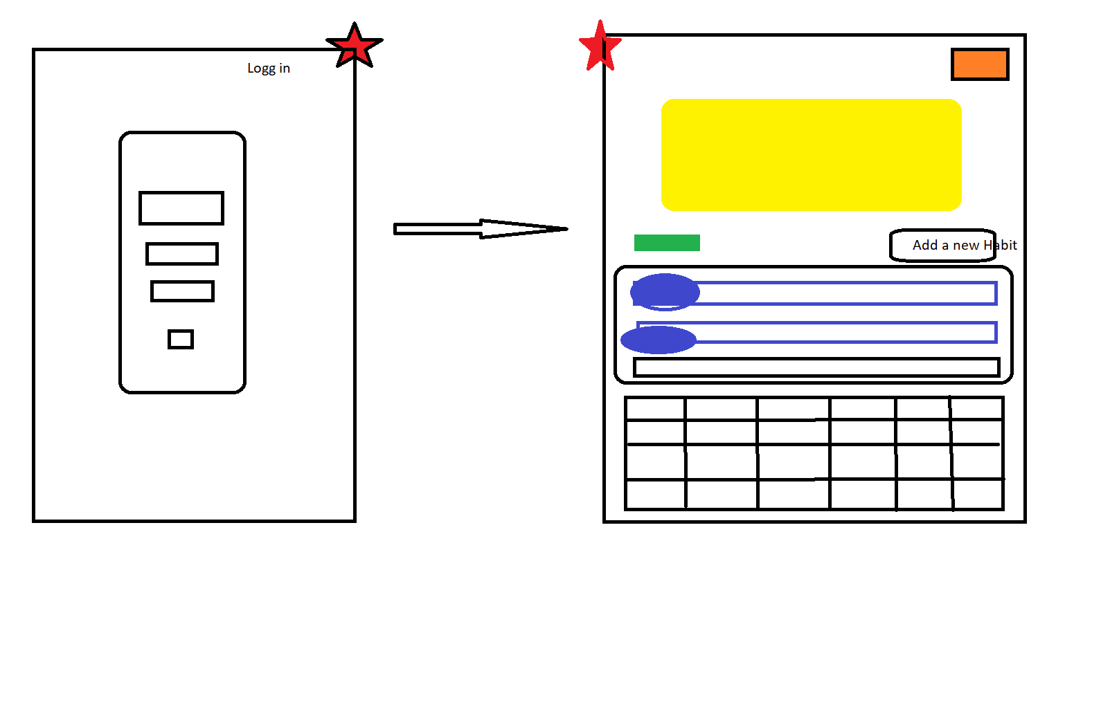
Lofi #4

Slide 8
Final Lofi Prototype
Demonstration

Slide 9
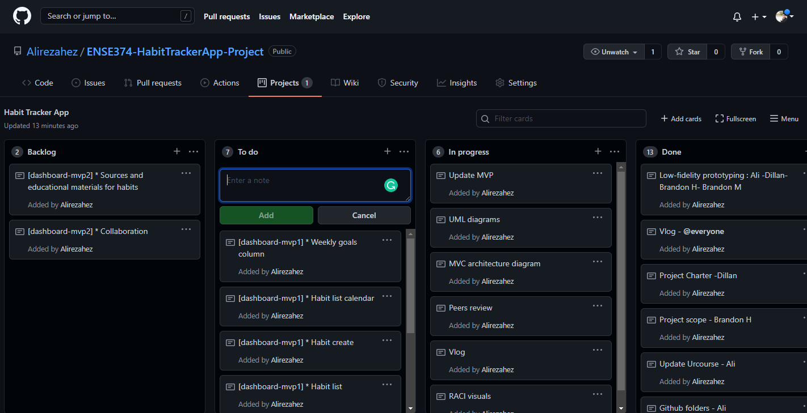
Kanban Board

Slide 10
Team Reflection
How did you feel about this activity? What did you like about it? What did you dislike about it?
What is your team most proud of with respect to the work accomplished in this project deliverable?
What did you learn about yourself as you collaborated and worked on this activity (individually and as a team)
How will you use (or not use) what you have learned/experienced in this activity going forward?
What "stuff & things" related to this activity would you like more help with?

Slide 11


